Slide 1
WIN World Survey World Health Index
Published: 5th April 2024
REF: 695423

Slide 2
WIN World Health Survey – Headlines Ireland Irish health perceptions lag behind global standards, with lower ratings on fitness, weight, and sleep quality. Stress is slightly more common, often due to family and financial worries.
1
2
3
Since 2020, Irish perception of considering themself as very healthy/healthy is deteriorating, with a 4% drop vs 2022 in health outlook and this especially prevalent amongst those aged 55+. Globally, Ireland has a lower ranking as well.
In terms of individual health aspects, Ireland falls below global standards in fitness, weight management, and sleep quality, although mental health and stress levels show slightly better levels globally.
Irish individuals are rating their fitness and weight levels lower compared to 2022, particularly those aged 35-54, while sleep is consistently poor across all but again weakest among mid-aged adults.
4
5
One in three individuals in Ireland report feeling stressed very or fairly often, with those under the age of 55 being significantly more affected. This rate is slightly higher than global averages.
In Ireland, job and employment-related concerns are less prevalent sources of stress. Instead, Irish individuals are more stressed about family, lack of money, health, and life changes compared to the global average.

Slide 3
of Irish consumers consider themselves healthy
2-in-3

Slide 4
Health perception is on decline each year since 2020
Global Average

Slide 5
Perception stronger among Younger Irish adults and white collar
Decline in self-reported health comes from all demographics; more evidently among ABC1 and those from Munster in 2024.
% consider their overall health generally to be…
‘Very Healthy/Healthy’
vs 2022
Self-Reported Health - Ireland
Unhealthy
Very Healthy
Total
Male
Female
18-34
35-54
55+
ABC1
C2DE
Dublin
ROL
Munster
Conn/Ulster
-4%
-4%
-4%
-5%
-4%
-5%
-6%
-2%
-3%
-3%
-8%
-2%
(-3%)
Gender
Somewhat
Unhealthy
Age
Social Class
Healthy
(-2%)
Region
67% (-4%)
NET Very Healthy/Healthy
( ) vs 2022
Indicates significant difference vs. Total
Indicates significant difference vs. 2022

Slide 6
Perceptions of one’s health are declining over time amongst older age groups
While 18-34-year-olds perception of overall health grew through pandemic years, those aged 55+ are steadily declining since that time.

Slide 7
On a global level, Ireland is behind average on health outlook
Asian nations like Indonesia, Vietnam, India, and Laos show high levels of self-perceived health among residents. Mexico, Paraguay, Malaysia, and France have notably improved health this year.
Health self-perception
Net: Unhealthy
Net: Healthy
Indicates significant difference vs. 2022

Slide 8
Irish perception on health aspects weaker than the global average, but stress/ mental health is better than average

Slide 9
Irish perceive their fitness, weight, & sleep lower than 2022
Strong improvement on Irish adults thinking they have good mental health and stress levels. The outlook is even better than global average.
Ireland’s Health aspects – those who rate ‘Very Good/Quite good’
Stress/ Mental health
Sleeping
Weight
Fitness
68%
(+8%)
58%
55%
(-7%)
48%
(-10%)
World Average | 66% | 68% | 66% | 66%
European Average | 66% | 68% | 62% | 59%
( ) vs 2022

Slide 10
Of Irish think their Mental Health/ Stress levels as good
68%

Slide 11
Significant rise in mental health perception across demographics
Despite yearly increases, individuals under 55 perceive their mental health and stress levels to be weaker.
Ireland’s Health aspects – those who rate ‘Very Good/Quite good’
2022 | 2024
Stress/ Mental Health
68%
Global Ave.
66%
Indicates significant difference vs. Total
Indicates significant difference vs. 2022

Slide 12
Mental Health/Stress levels slightly better vs global averages
With increasing global attention on mental health, noticeable enhancements in ratings are observed across most countries.
Overall health rating – Stress/ Mental Health
Very/ Quite Poor
Very/ Quite Good
Indicates significant difference vs. 2022

Slide 13
claim their sleeping levels as good, one of the lowest seen globally
58%

Slide 14
Evident economic divide on sleeping levels in Ireland
Rating is poorer vs global averages.
Ireland’s Health aspects – those who rate ‘Very Good/Quite good’
Sleeping
58%
Global Ave.
68%
Indicates significant difference vs. Total

Slide 15
Again, Ireland ranks near the bottom globally in sleep perception
Similar pattern observed for sleep like other health aspect with some Asian countries leading and Negeria, Peru being weak.
Overall health rating - Sleeping
Very/ Quite Poor
Very/ Quite Good

Slide 16
55%
Just over half consider their weight levels as good, notably weaker vs 2022

Slide 17
View on weight is weaker across all in Ireland
Females and those from Rest of Leinster have also dropped significantly on rating their weight as good along with fitness. Older cohort and ABC1 also have much weaker perceptions.
Ireland’s Health aspects – those who rate ‘Very Good/Quite good’
2022 | 2024
Weight
55%
Global Ave.
66%
Indicates significant difference vs. Total
Indicates significant difference vs. 2022

Slide 18
Ireland has one of the lowest weight perceptions globally
Asian countries like Indonesia, Vietnam, Pakistan, India lead with majority considering their weight as good.
Overall health rating - Weight
Very/ Quite Poor
Very/ Quite Good
Indicates significant difference vs. 2022

Slide 19
Under half claim their fitness levels as good, one of the lowest seen globally
48%

Slide 20
Evident drop in Irish view on their fitness level across most cohorts
Females, individuals in midlife, and those from the rest of Leinster exhibit have even lower ratings of fitness.
Ireland’s Health aspects – those who rate ‘Very Good/Quite good’
2022 | 2024
Fitness
48%
Global Ave.
66%
Indicates significant difference vs. Total
Indicates significant difference vs. 2022

Slide 21
Ireland have notably poorer fitness perception vs global standards
Ireland is only ahead of Serbia, Peru, and Croatia on fitness level.
Overall health rating - Fitness
Very/ Quite Poor
Very/ Quite Good
Indicates significant difference vs. 2022

Slide 22
1 in 3 Irish individuals report feeling stressed very or fairly often

Slide 23
Those aged under 55 years are stressed more often
How often do you feel Stressed?
Total | Male | Female | NET: 18-34 | NET: 35-54 | NET: 55+ | NET: ABC1 | NET: C2DE | Dublin | ROL | Munster | Conn/ Ulster
Very/fairly often
33%
often feel stressed
Sometimes
54%
55%
52%
50%
52%
59%
54%
53%
54%
54%
53%
53%
Never/ Almost never
Indicates significant difference vs. Total

Slide 24
Globally, Ireland is slightly higher on being stressed than average
Serbia and Palestine Territories have highest level of stress.
Overall health rating - Ability to do your daily activity by yourself
Very/fairly often
Sometimes
Never/ Almost never

Slide 25
Concern about family and lack of money are the most common cause for stress in Ireland

Slide 26
Irish are more stressed about family, money, health & life changes
While they experience less stress from Employment and job-related factors compared to the global average.
Ireland’s causes of stress
 | My family | Lack of money | My job | My health | Changes in life (moving, changing job) | The wars around the world | Lack of job/unemployment | Environmental disasters
 | 26% | 24% | 15% | 11% | 10% | 4% | 2% | 1%
World Average | 19% | 21% | 23% | 9% | 6% | 4% | 7% | 2%
European Average | 22% | 19% | 17% | 5% | 7% | 14% | 6% | 4%

Slide 27
1 in 5 Irish say they stress in worry of their family and money
Worry about job is higher among males, younger cohort, ABC! And those living in Dublin.
Ireland’s causes of stress
My family | Lack of money | My job | My health | Changes in life (moving, changing job) | The wars around the world | Lack of job / unemployment | Environmental disasters
26% | 24% | 15% | 11% | 10% | 4% | 2% | 1%
Male
Female
18-34
35-54
55+
ABC1
C2DE
Dublin
ROL
Munster
Conn/Ulster
Indicates significant difference vs. Total

Slide 28
In Ireland, job-related stress is less prevalent than in many other countries, with family, finances, and health being more common sources of stress
Job stress is high in Paraguay, Mexico, and Vietnam, while money is a major stressor in the Philippines and Malaysia.

Slide 29
Even stress stemming from unemployment and environmental disasters is below global standards in Ireland
Palestine T. experiences the highest level of stress due to concerns about wars, while Ecuador has the highest level of worry regarding unemployment.

Slide 30
Sample and Methodology
Methodology:
The WWS (WIN Worldwide Survey) is a study conducted every year with the purpose to measure people´s thoughts, expectations, worries and perceptions related to relevant topics for society and business.
Sample Size and Mode of Field Work:
A total of 33,866 people were interviewed globally. See below for sample details. The fieldwork was conducted during December 2023 – January 2024. The margin of error for the survey is between 2.4 and 4.4 at 95% confidence level.
The global average has been computed according to the share of the covered adult population of the surveyed countries.

Slide 31
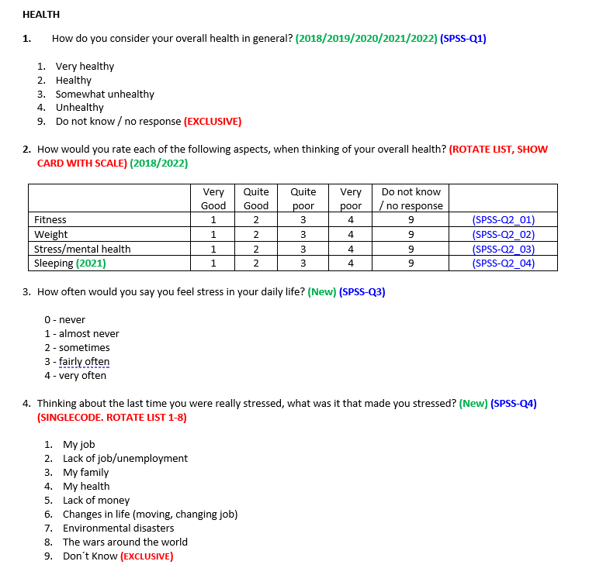
Questionnaire – World Health Index

Slide 32
About the WIN Survey
Media enquiries (worldwide data) Local Media Enquires (Irish data)
Elena Crosilla, WIN Coordinator Richard Colwell, CEO RED C Research
+39 335.62.07.347 +35318186316
E-mail: coordinator@winmr.com info@redcresearch.ie
About the WIN Survey
The Worldwide Independent Network of Market Research (WIN) is a global network conducting market research and opinion polls in every continent. RED C Research are the Irish members of the WIN network
Our assets are:
Thought leadership: access to a group of the most prominent experts and business entrepreneurs in Market Research, Polling and Consultancy
Flexibility: tailormade global and local solutions to meet clients’ needs
Innovation: access to the latest strategic consultancy, tool development and branded solutions
Local experts: access to a network of experts that truly understand the local culture, market and business needs
Trust: highest quality of talented members in all countries covered
In the years, WIN has demonstrated wide competences and ability to conduct multi-country surveys following the highest standards requested by the market. The accumulated expertise of the Association is formidable: Third World issues, advertising and media research as well as retail, economics, and corporate research.

