Slide 1
COVID-19 How can Brands Prepare for the “New Normal”?
May 2020

Slide 2
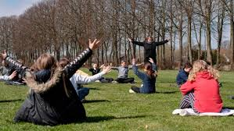
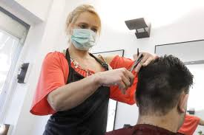
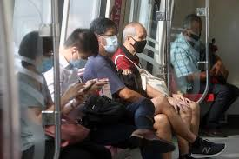
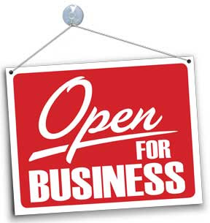
The Beginning of the End?
After more than a month of strict restrictions and lockdown across most of the European countries, we now see a significant easing of restrictions across the continent as Governments try to re-start the economy and our social lives. This follows a downward trend in number of new cases and COVID-19 related deaths but fears remain over a potential second wave of infections.
Denmark was the first country to allow smaller children back to school mid-April, with Germany, France and Belgium having also opened their schools in the past few weeks. Several countries now allow grandparents to hug their grandchildren, e.g. Switzerland and Italy.
Hairdressers have re-opened in some countries, e.g. Austria, Germany and Denmark. Even in hard hit Italy and Spain, restrictions are being eased with Italy allowing construction and factory workers back to work and Spain allowing some smaller retailers to re-open under strict conditions. Both Italy and Spain are also planning to allow tourists back over the summer.
Large gatherings, e.g. cultural and sporting events, remain banned across most countries and is likely to be banned until at least after the summer. Social distancing and hand hygiene rules are also here to stay for a long time while wearing masks in certain situations, e.g. public transport, is becoming mandatory in some European countries.
Ireland has laid out a comprehensive roadmap for easing the restrictions with the country having entering Phase 1 last week. Unlike other European countries, Sweden has chosen not to implement a lockdown but has instead chosen a strategy relying on personal responsibility rather than enforced restrictions.
What does this mean for brands?
With an opening of the economy on the horizon, brands need to prepare themselves for the “new normal”. Brand effort needs to focus on this “new normal” including new opportunities and challenges arising for this “new normal”.

Slide 3
Preparing for the “New Normal” – Tips for Brands
Maintain Public Health Measures
Embrace Digital
Design a “New” Customer Journey
Flatten the Seasonality Curve
Identify New Customer Segments or Revenue Streams
Keep Communicating!

Slide 4
Maintain Public Health Measures
While the lockdown is likely to end, the same is unfortunately not the case for COVID-19. Social distancing and hand hygiene rules are likely to stay in effect for the foreseeable future. Wearing masks in certain public and work situations could also become mandatory, e.g. hairdressers and public transport.
Brands need to ensure that they implement all relevant public health measures. Brands that are seen as effectively protecting both staff and customers are likely to be rewarded in terms of staff motivation and revenue.
While all workplaces need to ensure proper social distancing between staff, especially retailers need to come up with effective solutions to implement social distancing rules for both staff and customers in an effective way that does not undermine the customer experience and is easy to manage.
Moving away from the manual “crowd control” used currently, we expect more sophisticated systems to be utilised to manage crowds and possible breaches of social distancing rules, e.g. Internet of Things and Advanced Analytics. This will allow for more effective planning of staff numbers, store layout, seasonality and the customer journey. It will also help avoid long customer queues which could detract from the customer experience. Monitoring shop footfall has never been more important!
Embrace Digital
While we have seen growth in online shopping for many years at the expense of traditional brick-and-mortar shops, COVID-19 has truly brought about a digital revolution in our shopping and media habits. And while many are longing to visit retail shops again as they open up, we will not see online shopping drop back to the levels seen before COVID-19.
Not only have consumers experienced first-hand the advantages and ease of online shopping, they have also witnessed increased competition online with many traditional brands having upped their online presence during the crisis.
It is therefore vital for brands to continue to invest in their online channels for shopping, communication and customer service. Brands must also expect and facilitate more interaction between online and traditional shopping channels in the future, e.g. showrooming and webrooming.
With postal deliveries having been used extensively during the lockdown, we would expect a return of competitive click-and-collection models post-lockdown.

Slide 5
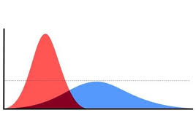
Design a “New” Customer Journey
Public health regulations and customer health concerns might mean an end to some “old” customer journeys, e.g. pubs and air travel. Successful brands must embrace this challenge and work on developing new customer journeys which are valued by customers while being profitable to the business.
One example is Tivoli Gardens, one of the oldest amusement parks in the world, located in Copenhagen, with an annual visitor number close to 5 million. When opening up in June, the customer journey could be very different than previously with strict social distancing rules in place and guests being encouraged to book their rollercoaster ride time slots online prior to the visit. Another example is the re-emergence of drive-in cinemas across Europe.
Here in Ireland, pubs will struggle with how to provide an authentic and socially rewarding experience, while implementing social distancing rules, e.g. table service only, limited toilet access and no live music.
Brands must be willing to think outside-the-box while allowing customers to feed into the new processes and journey.
Flatten the Seasonality Curve
Sticking with the pubs, how will they be able to make money if they can only fit a third of the usual patrons in on an average Saturday night? One solution could be to make the pub offering more attractive on weekdays to make up for the weekend shortfall.
Due to social distancing rules, space will become a limited resource, with brands and retailers exploring how to optimise revenue per square foot. This can be achieved through time specific advertising and price promotions generating customers when space is available and limiting customer flow during busy hours.
With airlines and the tourism industry being hardest hit by the COVID-19 crisis, it is especially important for these brands to explore how they can “flatten the seasonality curve”!

Slide 6
Identify New Customer Segments or Revenue Streams
Adjusting to the “new normal” is an opportunity for targeting new customer groups and developing new revenue streams.
During the crisis, several brands have done this with success, e.g. restaurants offering take away and supermarkets having shopping hours for vulnerable groups.
Some brands have even gone so far as to actively take part in solving the COVID-19 crisis, e.g. Jameson producing hand sanitiser and O’Neills manufacturing protective equipment for healthcare workers.
The “new normal” will be a challenging, but brands that approach this in an effective and innovative way might find themselves appealing to new target groups or even be able to develop new revenue streams for their business, including online sales.
Keep Communicating!
With the Irish economy facing a significant downturn, it can be tempting for brands to reduce their advertising and marketing spend.
However, learnings from the previous economic crisis in 2008 show that brands that did not cut advertising spend fared significantly better than brands which cut spend. Consistent spend and messaging is needed to protect brand health during the downturn and to be in the best possible position once the economy bounces back.
Evidence from RED C brand tracking surveys during 2008-2011 shows that hard won brand strengths were being steadily eroded when spend was cut off – with some brands seeing key emotional brand benefits drop by as much as 15-20%. Continuing with current spend however is likely to have a positive brand impact, especially in a less “noisy” advertising environment.
Furthermore, the media landscape has changed significantly during the COVID-19 crisis with an uplift in media usage across most channels but especially for live TV and digital media. Brands need to understand whether these changes in our media consumptions will be long term.

Slide 7
Jimmy Larsen
Director RED C Research & Marketing Ltd T / +353 1 818 6316 E / jimmy.larsen@redcresearch.ie W / www.redcresearch.ie

